Slide 1
A brief description of Open-Source Machine Learning Libraries
(To be covered in this course)

Slide 2
SciPy
The SciPy library is one of the core packages that make up the SciPy stack.
It provides many user-friendly and efficient numerical routines such as routines for numerical integration and optimization.

Slide 3
NumPy
NumPy is a package in Python used for Scientific Computing.

Slide 4
MatPlotLib
Matplotlib is a Python 2D graphs plotting library.
You can generate plots, histograms, power spectra, bar charts, errorcharts, scatterplots, etc., with just a few lines of code.

Slide 5
SciKit-Learn
Simple and efficient tools for data mining and data analysis
Built on NumPy, SciPy, and matplotlib
Provides useful for:
Classification
Regression
Clustering
Dimensionality Reduction
Feature Extraction and Normalization

Slide 6
Pandas
library written for :
providing high-performance, easy-to-use data structures and data analysis tools for the Python.
In particular, it offers data structures and operations for manipulating numerical tables and time series.

Slide 7
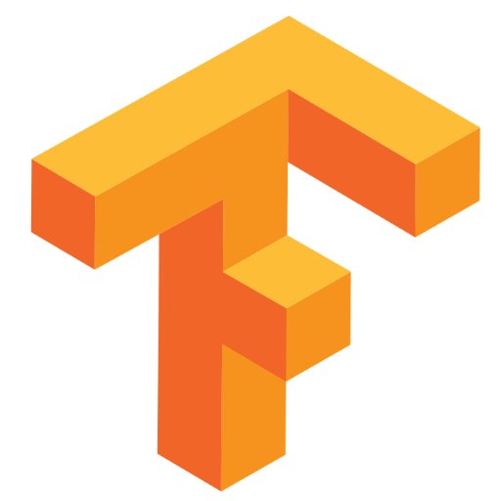
TensorFlow
An open source software library by Google for numerical computation using data flow graphs. In other words, the best way to build deep learning models.
It allows you to quickly setup, train and deploy multi-layered neural nets with large datasets.
It powers Google’s voice recognition and object identification from photos.

Slide 8

Keras
Keras is a high-level neural networks API, written in Python and capable of running on top of TensorFlow
It was developed with a focus on enabling fast experimentation.
This library :
Allows for easy and fast prototyping.
Supports both convolutional networks and recurrent networks, as well as combinations of the two.

